Slide 1

Software requirements (swr302)
Validating the Requirements
(chapter 17)

Slide 2
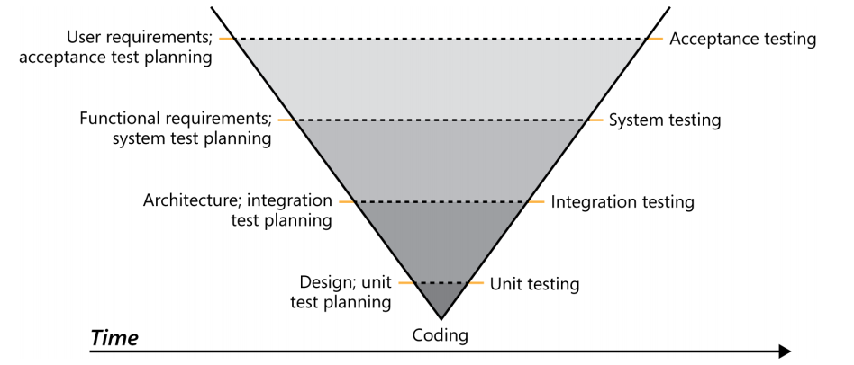
Why validate the requirements?

Slide 3
Validation and verification
Verification determines whether the product of some development activity meets its requirements (doing the thing right).
Validation assesses whether a product satisfies customer needs (doing the right thing).
Requirements validation activities:
The software requirements accurately describe the intended system capabilities and properties that will satisfy the various stakeholders’ needs.
The software requirements are correctly derived from the business requirements, system requirements, business rules, and other sources.
The requirements are complete, feasible, and verifiable.
All requirements are necessary, and the entire set is sufficient to meet the business objectives.
All requirements representations are consistent with each other.
The requirements provide an adequate basis to proceed with design and construction

Slide 4
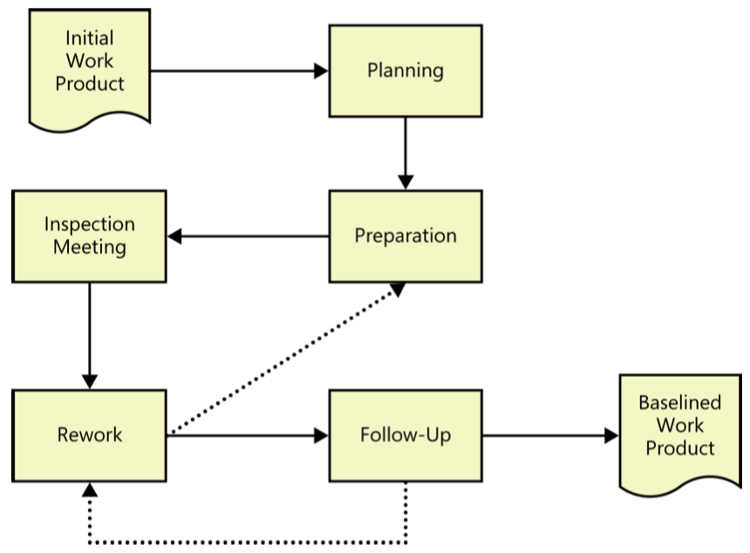
Reviewing requirements
Reviewing requirements is a powerful technique for identifying ambiguous or unverifiable requirements, requirements that aren’t defined clearly enough for design to begin, and other problems
Informal review approaches:
A peer deskcheck
A passaround
A walkthrough
The inspection process
Author
Moderator
Reader
Recorder
Notes:
A peer deskcheck, in which you ask one colleague to look over your work product.
A passaround, in which you invite several colleagues to examine a deliverable concurrently.
A walkthrough, during which the author describes a deliverable and solicits comments on it.

Slide 5
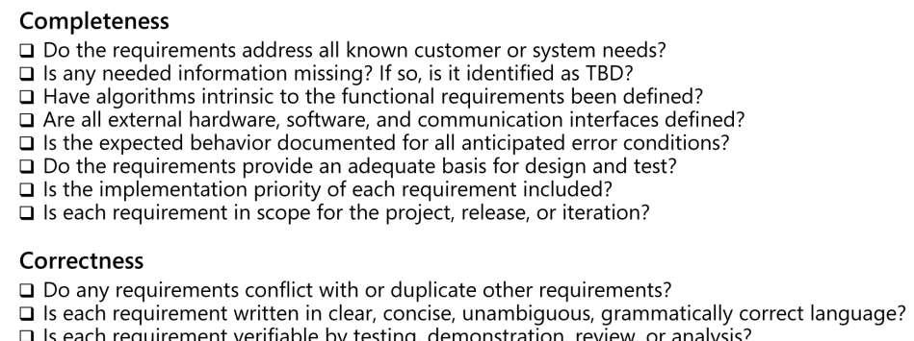
Reviewing requirements Defect checklist
Completeness
Correctness
Quality attributes
Organization and Traceability
Other issues

Slide 6
Reviewing requirements Tips & Challenges
Reviewing tips
Plan the examination
Start early
Allocate sufficient time
Provide context
Set review scope
Limit re-reviews
Prioritize review areas
Review challenges
Large requirements documents
Large inspection teams
Geographically separated reviewers
Unprepared reviewers

Slide 7
Prototyping requirements
Prototypes are validation tools that make the requirements real
Visualize how a system will function under specific circumstances
Allow user to experience some aspects of what a system based on the requirements would be like
Allow you to find missing requirements before more expensive activities like development and testing take place
Prototypes also help confirm that stakeholders have a shared understanding of the requirement
Proof-of-concept prototypes can demonstrate that the requirements are feasible
Evolutionary prototypes allow the users to see how the requirements would work when they are implemented, to validate that the result is what they expect

Slide 8
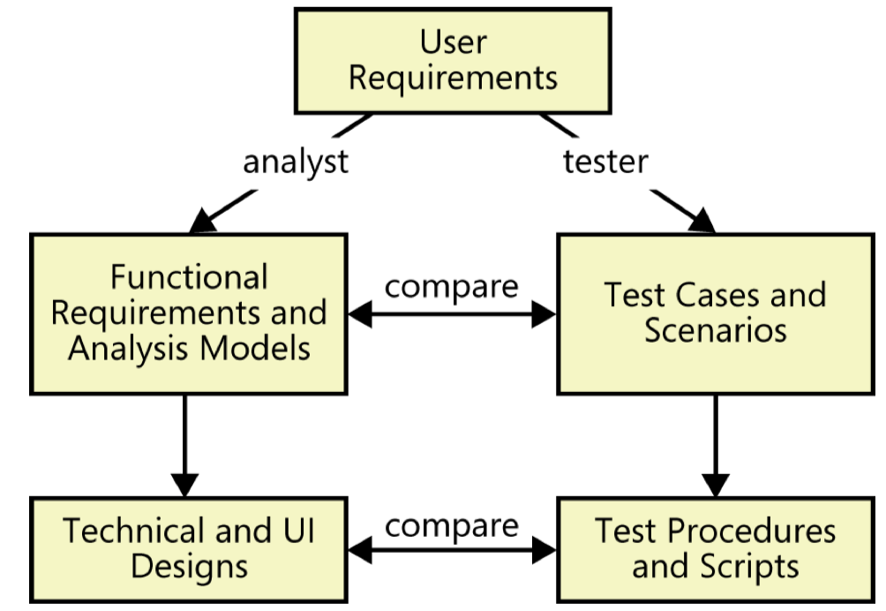
Testing the requirements
Development and testing work products are derived from a common source.

Slide 9
Validating requirements with acceptance criteria
Specific high-priority functionality that must be present and operating properly before the product could be accepted & used
Essential nonfunctional criteria or quality metrics that must be satisfied
Remaining open issues and defects
Specific legal, regulatory, or contractual conditions.
Supporting transition, infrastructure , or other project (not product) requirements

Slide 10


